Slide 1
Valence Bond Theory
Hybridization

Slide 2
Valence Bond Theory Normal
developed by Linus Pauling
Concerned with HOW element share electrons in a covalent bond
his theory states that when two atoms covalently bond their valence orbitals occupy the same space (OVERLAP) becoming one combined orbital with electrons spinning in opposite directions
Only two electrons maximum can occupy this new combined orbital
Any two half filled orbitals can overlap in this way

Slide 3
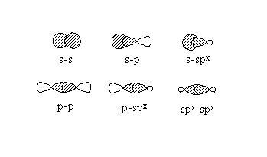

Slide 4
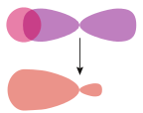
Valence Bond Theory still Normal…….
When the orbitals overlap the atoms arrange themselves such that the maximum overlap is obtained
This will leave a large electron density between the two elements on the x axis with a small node on the opposite side.

Slide 5
Do you see a Problem with Carbon?
Think about quantum theory
Carbon ends is 2s² and 2p²
How many bonds should it form? Will all those bonds be equal?
NO so how does it manage 4 equal bonds with orbital overlaps?

Slide 6
Valence Bond Theory Kind of Weird……… Hybrid Orbitals
VSEPR tells us that carbon can form tetrahedral structures
Valence bond theory needs to explain this and cannot with simple s, p orbital overlaps
a combination of the s orbital with one, two or three of the p orbitals to form sp, sp² and sp³ orbitals respectively
carbon has the ability to form 4 sp³ hybrid orbitals that are all the same shape and size and differ only by orientation in space

Slide 7
Valence Bond Theory Kind of Weird……… Hybrid Orbitals
only formed when bonding occurs
form SPONTANEOUSLY
do NOT exist in an isolated atom
this ensures that the centre atom has a Noble gas configuration
What about atoms that form covalent bonds without an octet?
(BF₃, BeH₂)
Pauling suggested an entire series of hybridizations could occur they are as follows:

Slide 8
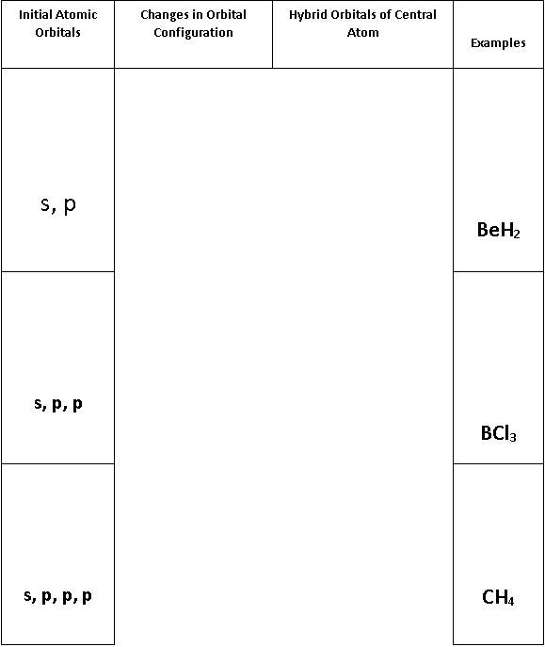
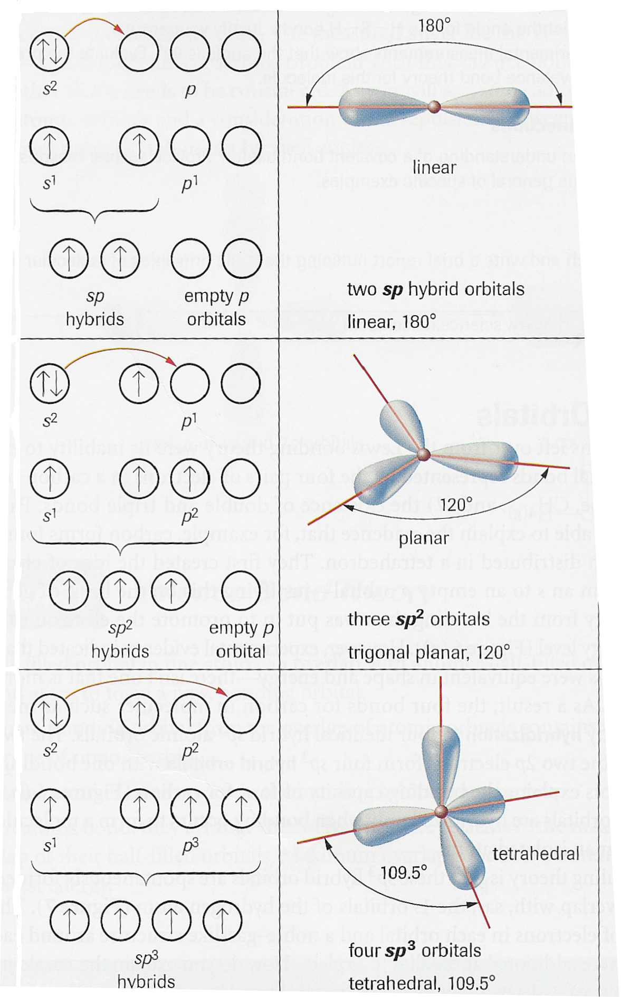

Slide 9
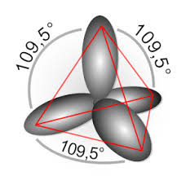
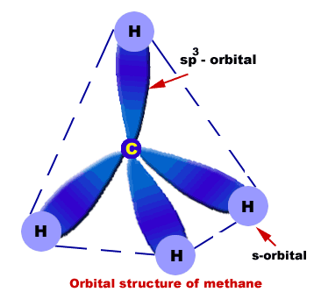

Slide 10
Complex Hybrids
some atoms form more than four bonds are the EXCEPTION TO OCTET
these atoms also form hybrid orbitals
since there are more than 4 bonds there must be more than 4 hybrid orbitals
How is this Possible?
Answer: hybrid orbitals that form with the s p and d subshells

Slide 11
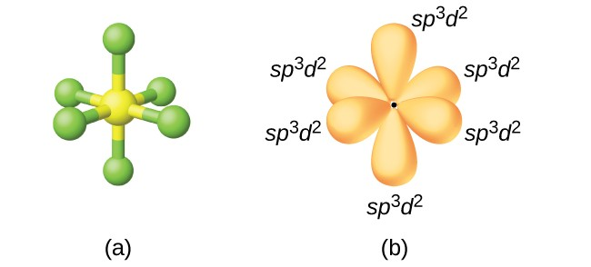

Slide 12
Rules for Hybridization
There must be at least one electron in the s, p or d orbital in order to hybridize them. (this is why promotion is sometimes necessary)
Only two electrons can exist in each hybrid orbital.
Hybridization can only occur with s, p and d orbitals that have the same principle quantum number.

Slide 13
Valence Bond Theory
Valence bond theory states that hybrid orbital overlap when forming a covalent bond.
Hybrid orbitals will always maximize their electron density between the two atoms along the x axis.
This first bond is referred to as the sigma bonds.
Most sigma bonds are between hybrid orbitals

Slide 14
Double and Triple Bonds
If atoms need to share more than 1 electron pair they cannot overlap their next set of orbitals along the x axis
Thus they must resort to overlapping on the y-axis and thus these orbitals
do not hybridize
The second bond (of a double bond) is called a pi bond and is formed always with p orbitals
If a triple bond is required the electron density will be along the z axis
This is also called a pi bond and thus is in p orbitals

Slide 15
